Slide 1
Octank E-Commerce on AWS
US E-Commerce Architecture PoC
Jungsub Shin
Solutions Architect

Slide 2
Agenda
Remind Requirements, Proposed Architecture
PoC Scenarios
Cost Analysis
Next Steps

Slide 3
Remind Requirements
US E-Commerce Service Overall Architecture
3-tier Architecture
EKS
EKS Configuration
CI/CD Pipeline, GitOps
Monitoring
Log, Metric, Event, Tracing
Disaster Recovery
Availability Zone DR : RPO = 0 min / RTO < 10 min
Region DR : RPO < 10 min / RTO < 30 min

Slide 4

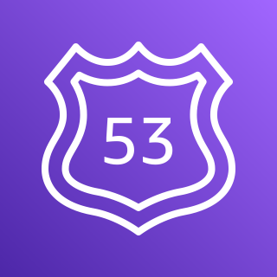




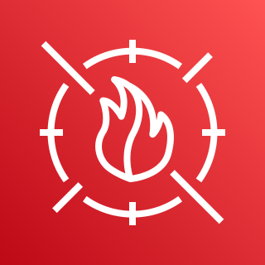



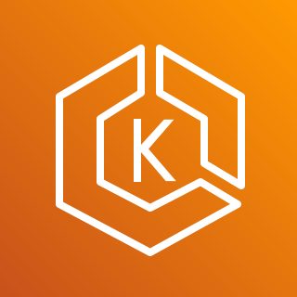

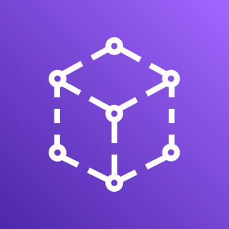


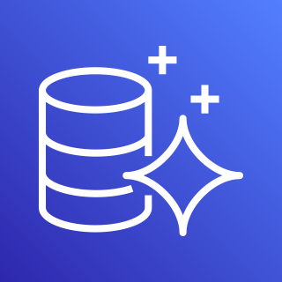
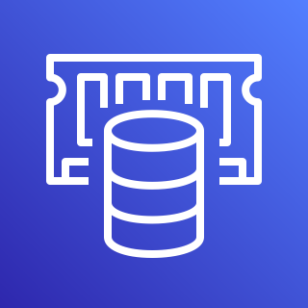






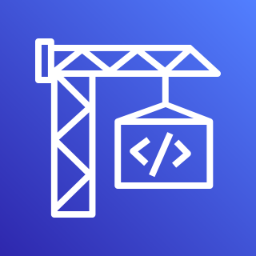






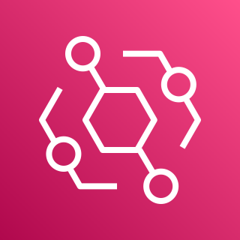



Remind Proposed Architecture
AWS Cloud
Confidential Data Store
Security
IaC
Load Balancing
Route 53
(DNS Server)
ACM
(Cert Store)
Secrets Manager
(Credential Store)
IAM
(Auth)
Shield
(DDoS Protect)
WAF
(L7 Firewall)
GaurdDuty
CloudFormation
EKS Cluster (K8s)
App Data Store
Personalization
ALB (L7 Load Balancer)
App Mesh
Client
Static Contents
Web Server
Containers
App Server
Containers
EFS
(NFS Server)
S3 (ML
Dataset Store)
Step Functions
Personalize
RDS Aurora
(DB)
ElastiCache
(Redis)
CloudFront
(CDN)
CI
CD, GitOps
Monitoring
S3 (Static Contents Store)
CodePipeline
CodeBuild
ECR
(Registry)
ArgoCD
X-Ray
(Tracing)
CloudWatch
(Log, Metric)
SNS
(Event Pub)
Chatbot
EventBridge
Botkube
Git Repo
(Service Code)
Git Repo
(K8s Manifest)
Slack

Slide 5




PoC 1 : 3-Tier Architecture on EKS Cluster
Ingress : ALB, Certificate Manager, Route 53
App Data Store : Aurora RDS, EFS
Monitoring : Collecting Metric, Logging
EKS Cluster (K8s)
Route 53
(DNS Server)
Manage Node
Group
Web Server
Node Group
App Server
Node Group
EC2
EC2
EC2
Client
ALB (L7 Load Balancer)
EFS
Controller
Web Server
Web Server
App Server
App Server
RDS Aurora
(DB)
EFS
(NFS Server)
ExternalDNS
Controller
ALB
Controller
Fluentd Bit
CloudWatch
Agent
Fluentd Bit
CloudWatch
Agent
CloudWatch
Agent
ACM
(Cert Store)
Fluentd Bit
EFS Node Plugin
CloudWatch
Logs
CloudWatch
Metrics

Slide 6
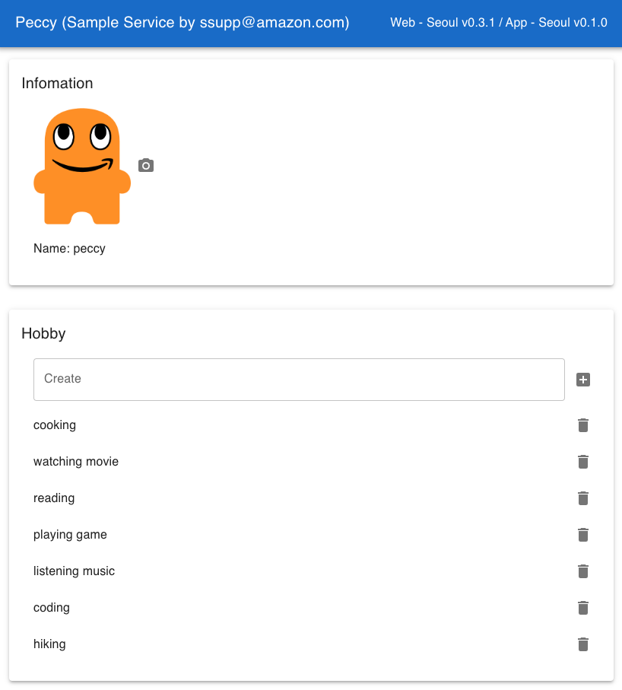
Sample Service for Demo
Version Info
Peccy Service
https://peccy.aws-playground.dev/
3-Tier Architecture
Client Side Rendering
RDS Aurora (DB), EFS (NFS) 이용
EFS Data
RDS Aurora Data

Slide 7

PoC 2 : Continues Integration
Unit Test 수행
Container Image Build, Push 수행 + Registry 이중화
CI 처리 상태를 Service Developer, DevOps Engineer에게 전달
CodePipeline
Pull
Request
Merge Event (Webhook)
5
ECR in Seoul (Registry)
Container
Image
1
2
4
Service Developer
Git Repo
(Service Code)
CodeBuild
/ Run
Unit Test
CodeBuild
/ Build & Push
Container Image
ECR in Tyoko (Registry)
Notification
Notification
Chatbot
Slack
Service Developer
& DevOps Engineer

Slide 8
PoC 3 : Continues Delivery with GitOps
K8s Manifest를 Git Repo에서 관리
Git Repo에 저장된 K8s Manifest를 자동으로 EKS Cluster에 적용
배포 상태를 Service Developer, DevOps Engineer에게 전달
EKS Cluster (K8s) in Seoul
Manage Node
Group
Web Node
Group
App Node
Group
Manage Node
Group
Pull
Request
Polling
(Auto Sync)
Request to Apply K8s Manifests
K8s Events
1
2
4
Web Server
Containers
App Server
Containers
6
Service Developer
& DevOps Engineer
Git Repo
(K8s Manifests)
ArgoCD
Botkube
Slack
3
K8s Manifests
Container Image
Service Developer
& DevOps Engineer
5
ECR in Seoul (Registry)

Slide 9
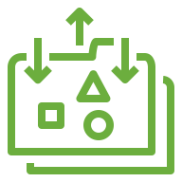
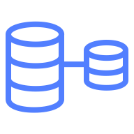


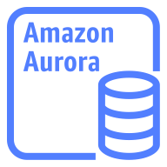
PoC 4 : Availability Zone DR – Architecture
EKS Cluster (K8s)
EFS
RDS Aurora
Web Server
Node Group
App Server
Node Group
EFS Storage
(Multi-AZ)
RDS Aurora Storage
(Multi-AZ)
Route 53
(DNS Server)
Availability Zone
Writer Instance
Client
Availability Zone
Reader Instance
ALB (L7 Load Balancer)
Availability Zone
Reader Instance
Steady State
Availability Zone Down
EKS Cluster (K8s)
EFS
RDS Aurora
Web Server
Node Group
App Server
Node Group
EFS Storage
(Multi-AZ)
RDS Aurora Storage
(Multi-AZ)
Route 53
(DNS Server)
Availability Zone
Writer Instance
Client
Availability Zone
Writer Instance
ALB (L7 Load Balancer)
Availability Zone
Reader Instance

Slide 10
PoC 4 : Availability Zone DR – Service Level
ALB
ALB는 Health Check를 통해서 정상 상태의 Web/App Server Container에게만 Traffic 전달
Web/App Server에서 Health Check Endpoint 제공 필요
Web/App Container
EKS Cluster는 Web/App Server Container의 Auto Failover 수행
5분 대기 필요
RDS Aurora
RDS Aurora는 Writer Instance의 Auto Failover 수행
App Server에서 RDS Aurora로 Reconnection 수행 필요
RDS Aurora는 Muti-AZ Stoarge를 통한 Data 보존
EFS
EFS ENI 이중화를 통한 EC2 Instance에서 EFS로의 접근 경로 확보
EFS는 Muti-AZ Storage를 통한 Data 보존

Slide 11
PoC 4 : Availability Zone DR – How Simulate ?
Availability Zone Network Down
FIS (Fault Injection Simulator) Service를 활용하여 Subnet Down
RDS Aurora Writer Instance Down
강제 Failover 수행을 통해서 Writer Instance Down 및 교체

Slide 12
PoC 5 : Region DR – Architecture
Failover Routing
Primary EKS Cluster (K8s)
Manage
Node Group
Web Server
Node Group
App Server
Node Group
Route 53
(DNS Server)
ALB (L7 Load Balancer)
EFS (Source,
Writable)
RDS Aurora (Primary,
Writable)
Seoul Region
Tyoko Region
Secondary EKS Cluster (K8s)
Cross-region Replication
Client
Manage
Node Group
Web Server
Node Group
App Server
Node Group
Cross-region Replication
Git Repo
(K8s Manifest)
ALB (L7 Load Balancer)
EFS (Destination,
Read-only)
RDS Aurora (Secondary, Read-only)
Steady State
Region Down
Failover Routing
Primary EKS Cluster (K8s)
Manage
Node Group
Web Server
Node Group
App Server
Node Group
Route 53
(DNS Server)
ALB (L7 Load Balancer)
EFS (Source,
Writable)
RDS Aurora (Secondary,
Read-only)
Seoul Region
Cross-region Replication
Tyoko Region
Secondary EKS Cluster (K8s)
1
2
Client
Manage
Node Group
Web Server
Node Group
App Server
Node Group
Git Repo
(K8s Manifest)
ALB (L7 Load Balancer)
EFS (Source,
Writable)
RDS Aurora (Primary, Writable)
3
3

Slide 13
PoC 5 : Region DR – Service Level
EFS
Cross-region Replication을 통한 Data 복제 수행
장애 발생시 Cross-region Replication 제거
RDS Aurora
Cross-region Replication을 통한 Data 복제 수행
장애 발생시 Global Database Failover를 수행하여 Primary Cluster 변경
EKS Node Group, Web/App Container
장애 발생시 Secondary EKS Cluster의 Node Group의 Node 개수 추가
EKS Cluster는 Node 개수 증가 이후 Web/App Container 생성
Route 53
Failover Routing을 활용하여 Primary EKS Cluster 장애 발생시 자동으로 Secondary EKS Cluster로 Traffic 전달
ALB의 Health Check 결과를 바탕으로 장애 판단 수행

Slide 14
PoC 5 : Region DR – How Simulate ?
Region Network Down
Primary EKS Cluster 내부의 Web/App Container Down
Primary RDS Aurora Cluster Down
강제 Global Database Failover 수행을 통해서 Writer Instance 교체
Primary EFS Down
강제 Cross-region Replication 삭제를 통해서 Fail Over 수행

Slide 15
Cost Analysis – Main Cost Factors, Presumption
Region
Primary Region : us-west-1 (California)
Secondary Region : us-east-1 (Virginia)
Traffic
TPS (Transaction Per Seconds) : 1000
1 Month Traffic : 30 TB
App Data Storage
RDS Aurora Storage : 32GB
EFS Storage : 1 TB, Standard Class
EC2 Instance
EKS Web Node Group : M6i.xlarge X (10 or 0)
EKS App Node Group : M6i.xlarge X (10 or 0)
EKS Manage Node Group : t4g.medium X 2
RDS Aurora : db.r6g.2xlarge X 2

Slide 16
Cost Analysis – Primary Region Cost (us-west-1)
Cost Factor | Details | Cost (Monthly)
ALB Maintenance | 3 ALB | 55 USD
ALB Traffic | 30 TB | 1104 USD
Certificate Manager | 1 Certificate | 400 USD
RDS Aurora EC2 Instance | 2 X db.r6g.2xlarge | 1673 USD
RDS Aurora Storage | 32 GB, 1000 IOPS | 581 USD
EFS Storage | 1024 GB | 337 USD
EKS Control Plane | 1 Control Plane | 73 USD
EKS EC2 Instance (Savings Plan, 3 Years) | 20 X M6i.xlarge (1752 USD), 2 X t4g.medium (46 USD) | 1798 USD
Total |  | 6021 USD

Slide 17
Cost Analysis – Secondary Region Cost (us-east-1)
Cost Factor | Details | Cost (Monthly)
ALB Maintenance | 3 ALB | 55 USD
ALB Traffic | 0 TB | 0 USD
Certificate Manager | 1 Certificate | 400 USD
RDS Aurora EC2 Instance | 2 X db.r6g.2xlarge | 1515 USD
RDS Aurora Storage | 32 GB, 0 IOPS | 4 USD
EFS Storage | 1024 GB | 337 USD
EKS Control Plane | 1 Control Plane | 73 USD
EKS EC2 Instance (Savings Plan, 3 Years) | 2 X t4g.medium | 33 USD
Total |  | 2417 USD

Slide 18
Next Steps
Introduce
Auto Scaling (Pod, EKS Node)
CloudFormation Service
Personalize Service
Security Services

